Slide 1
Applications of nuclear techniques in agriculture
V. P. Venugopalan
Nuclear Agriculture and Biotechnology Division
Bhabha Atomic Research Centre
Trombay, Mumbai
Maharashtra 400 085

Slide 2
Nuclear techniques in agriculture
Crop improvement through mutation breeding
Pest/insect control through Sterile Insect Technique
Development of efficient microbes that can be used as biopesticides/biocontrol agents
Radiation de-polymerisation of biopolymers to be used as bio-stimulants
Radiation-polymerized superabsorbent hydrogels to enhance soil moisture retention
Use of radiotracers to study nutrient uptake

Slide 3

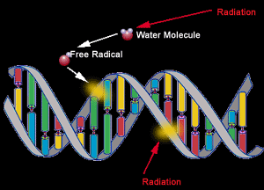
Radiation can be used to make genetic changes

Slide 4

IMPORTANT GOALS OF MUTATION BREEDING
Yield enhancement
Early maturation
Qualitative improvement (e.g., better nutritional quality)
Resistance to pathogens and pests
Tolerance to abiotic stresses (salinity, heat stress)

Slide 5
Are mutation-bred crops safe?
No foreign gene(s) introduced (so, these are not GM crops)
Existing gene(s) of the plant are only altered (removed or rearranged).
No residual radioactivity
Mutation is a natural process, but very slow.
In induced mutation, the process is just accelerated.
All the mutant varieties undergo rigorous quality testing before release for cultivation

Slide 6
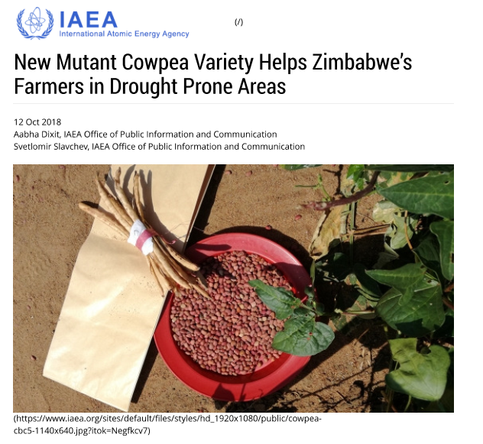
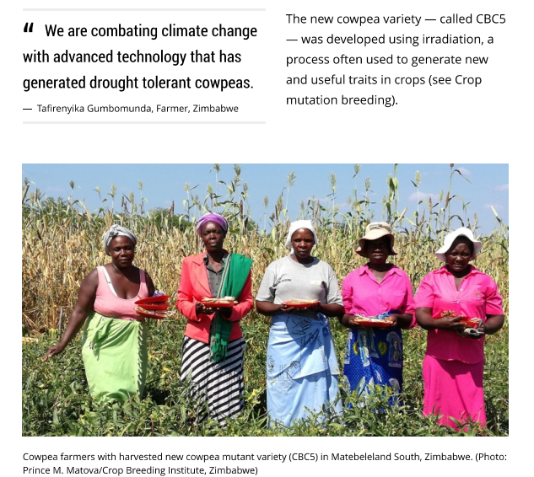

Slide 7
Mutant cultivars released in various countries
Country | No. of mutant cultivars | % of total
China | 810 | 24.9
Japan | 481 | 14.8
India | 343 | 10.5
Russia | 216 | 6.6
Netherlands | 176 | 5.4
Germany | 171 | 5.2
USA | 139 | 4.2
Others: Pakistan (53), Bangladesg (44), Canada (40), France (38), Italy (35), Korea (35), U.K. (34)
Source: IAEA

Slide 8
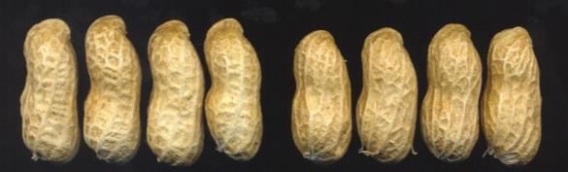
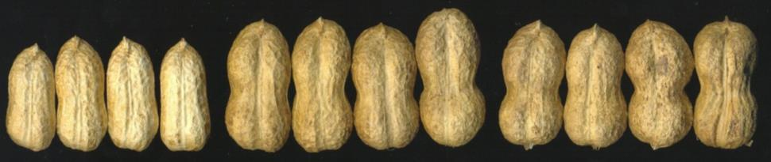
Mutations for variability… pod type in groundnut
Parallel reticulation
Parent TGM 94
Dumb-bell pod
Parent TGM 59 TGM 117

Slide 9
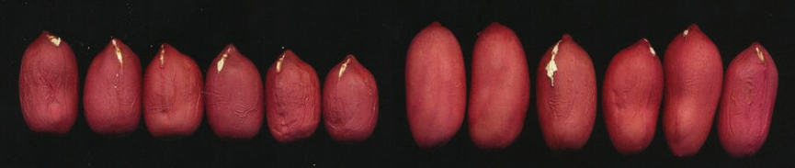
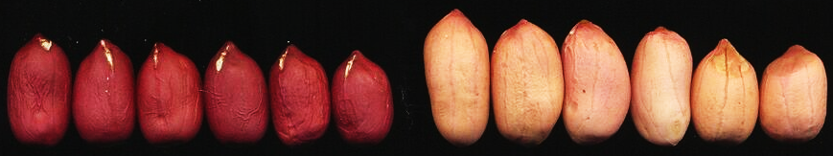
Mutations for variability… seed colour in groundnut
Parent Mutant
Parent Mutant

Slide 10
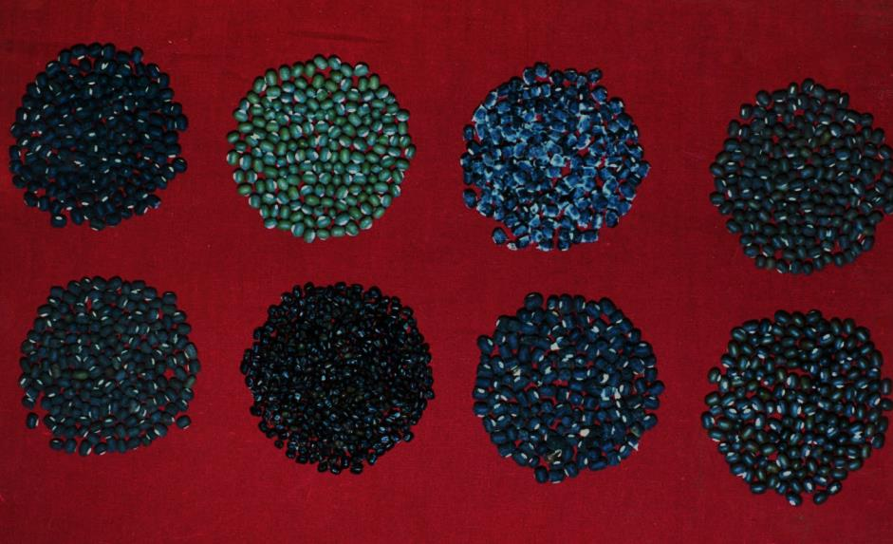
Mutations for variability… Seed colour in mungbean

Slide 11
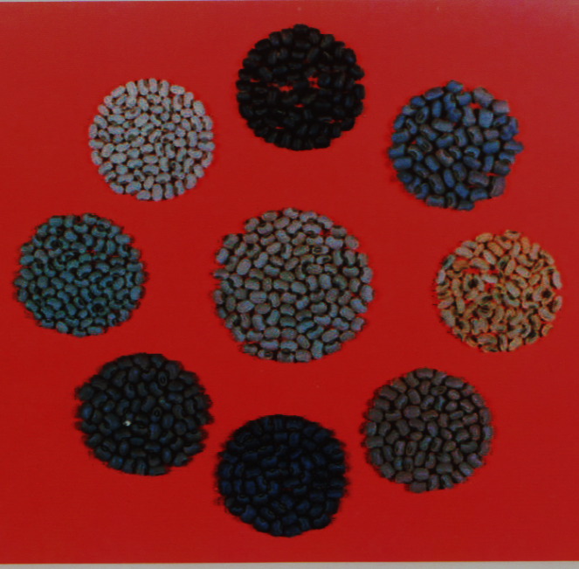
Mutations for variability… seed color in cowpea

Slide 12
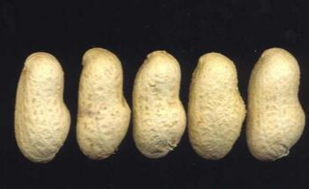
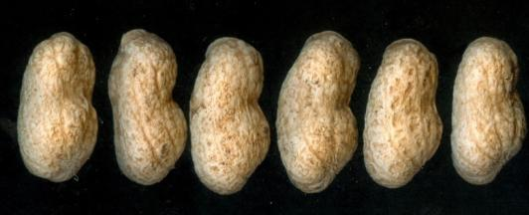
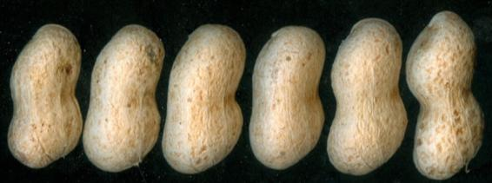
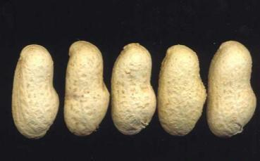
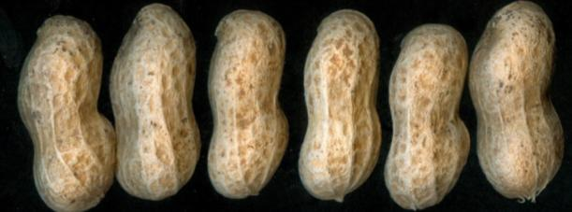
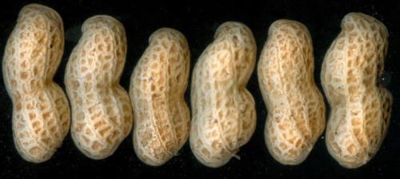
New gamma ray induced large seed mutants in groundnut
TG 38 (Parent) TG 72 TG 73
TG 38 (Parent) TG 78 TG 79
Undergoing testing in national & state groundnut evaluation trials

Slide 13
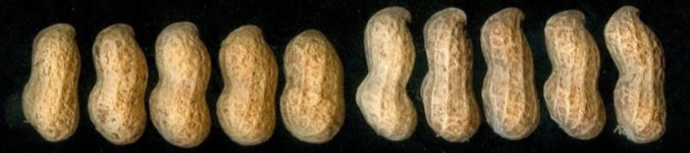
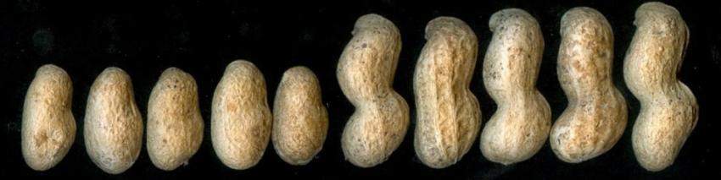
New electron beam induced large seed mutants in groundnut
Parent TAG 24 Mutant TG 87
Parent TG 26 Mutant TG 89
42% 36% 11% 36% 32% 25%

Slide 14

Crop improvement programme in BARC
Oilseeds | Pulses | Cereals
Groundnut | Mung bean | Rice
Mustard | Urid bean | Wheat
Soybean | Pigeon pea | Sorghum
Sunflower | Cowpea
Linseed | Chickpea

Slide 15

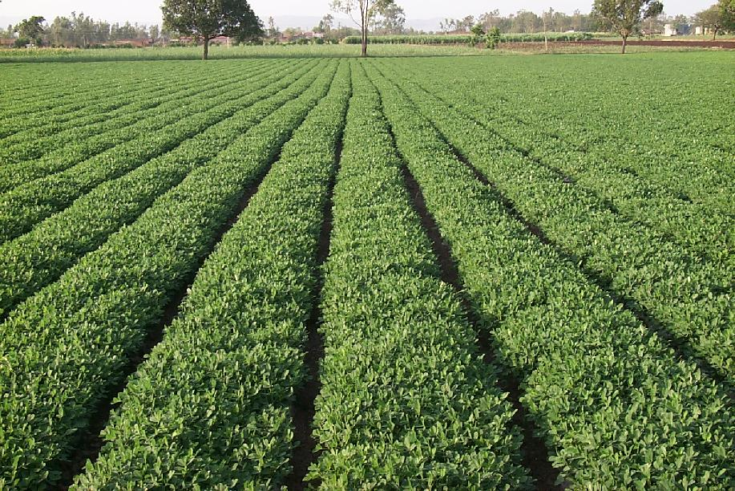
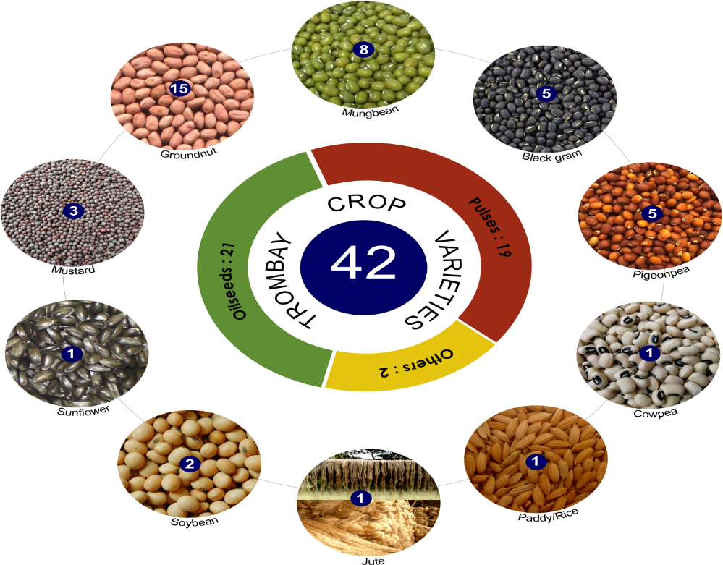
Trombay Crop Varieties Released & Notified by GoI
for Commercial Cultivation

Slide 16
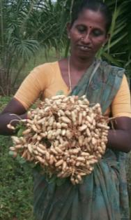
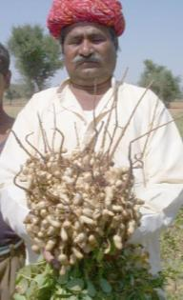
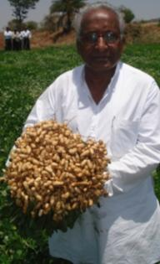
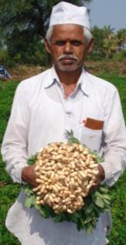
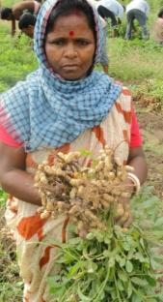
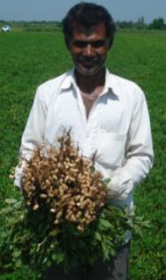
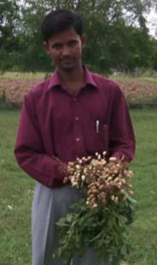
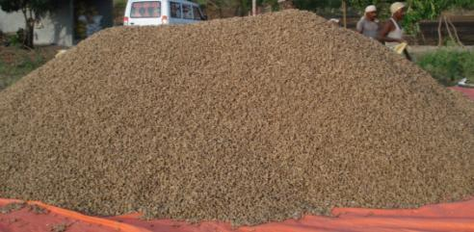
Trombay groundnuts cultivated across states
Andhra Pradesh Rajasthan Karnataka Maharashtra West Bengal
Gujarat Uttar Pradesh

Slide 17
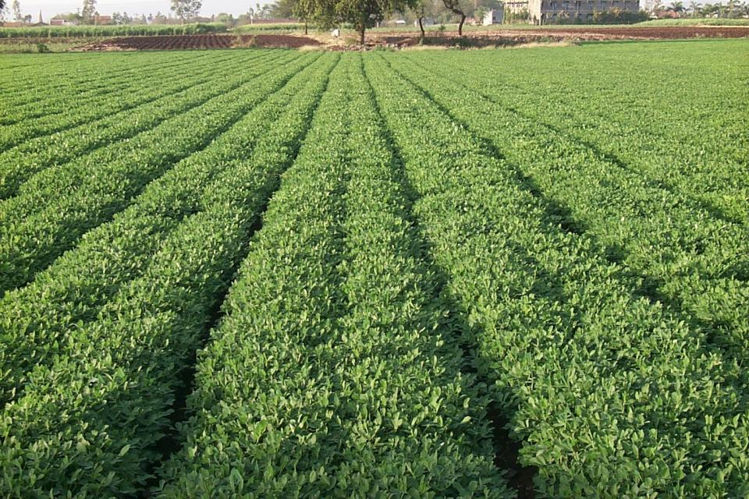
Breeder seed production in groundnut
Every year, around 1000-1500 quintals (~ 10% of national) breeder seed of TG varieties is supplied to seed agencies, NGOs, pvt. companies and farmers.

Slide 18
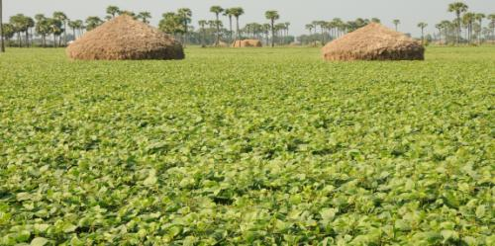
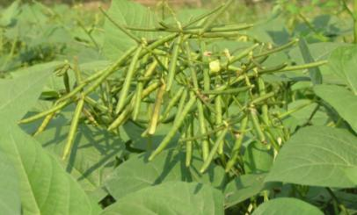

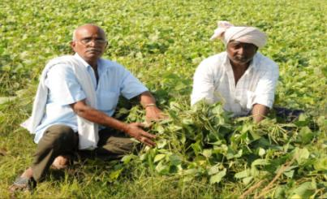
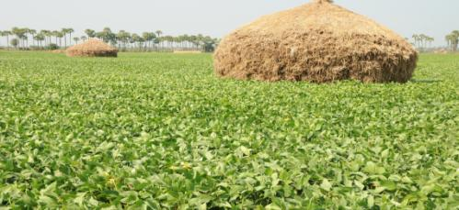

Popular Trombay Pulse Varieties Suitable for Rice Fallows
Mungbean: TM-96-2
Mungbean: TM-2000-2 (Pairy mung)
Uridbean : TU-40
Trombay Mung in Rice Fallows

Slide 19
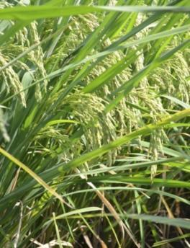
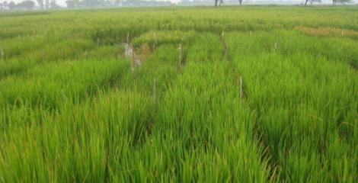

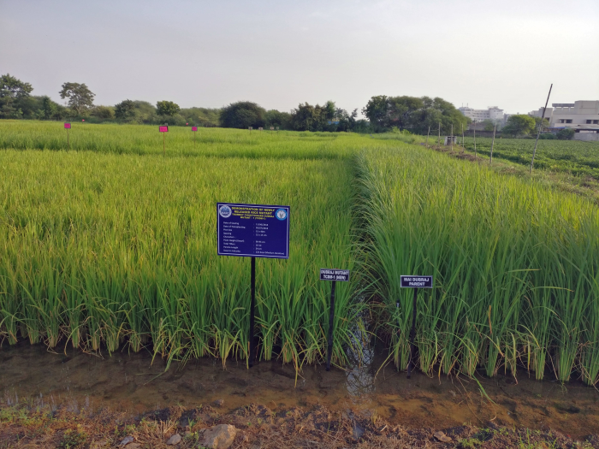
RICE : release of mutant varieties with better yield
Non-tolerant
Tolerant
BARC KKV 13
BARC KKV 17
Screening of rice selections for salinity tolerance
Dubraj – parent and mutant
 | Yield (Kg/ha) | Panicle/ m² | Grains/ panicle
BARCKKV13 | 3949 (↑29.4%) | 248 (↑6 %) | 213 (↑26.7%)
Karjat 4 | 3045 | 234 | 168

Slide 20
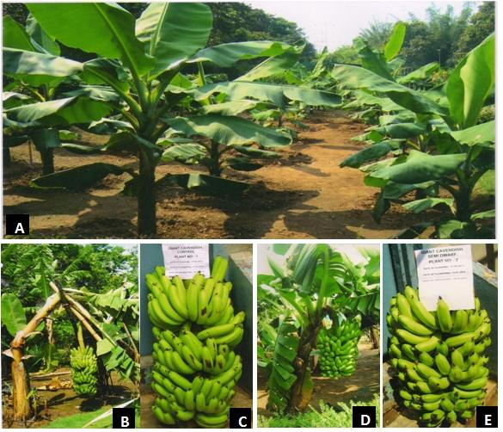
Gamma irradiation derived dwarf mutant in banana cultivar Giant Cavendish (AAA)
Giant Cavendish. A: Field view , B & C: Control plant- Tall and susceptible to lodging along with the harvested bunch D & E : TBM-2 mutant of Giant Cavendish at maturity stage along with the harvested bunch.

Slide 21
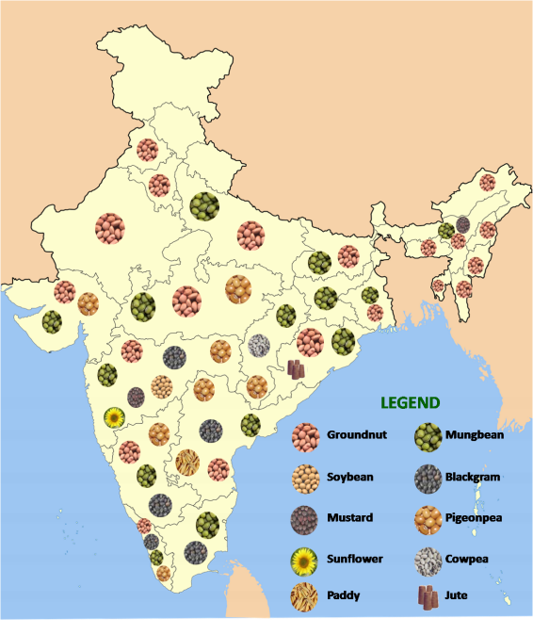
Dissemination of Trombay
Crop Varieties

Slide 22
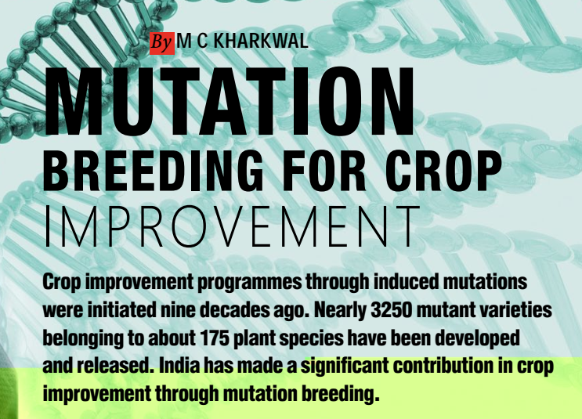
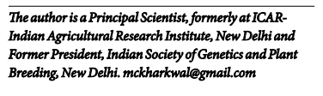
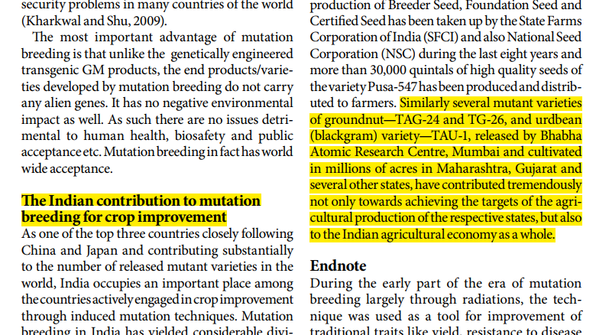

Slide 23
Applications in agricultural biotechnology

Slide 24
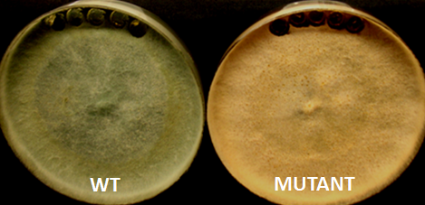
Trichoderma biopesticide
Parent (wild strain) Mutant

Slide 25
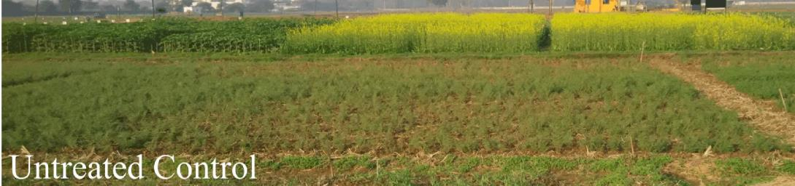
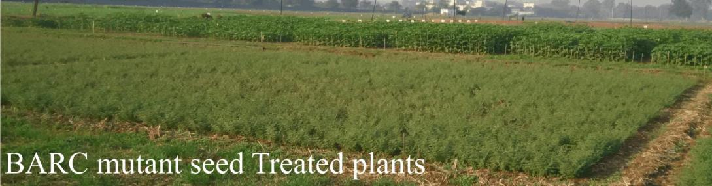
FIELD PERFORMANCE OF MUTANT STRAIN AT RAIPUR 2016
Trichoderma biopesticide is used for disease control in the field.

Slide 26
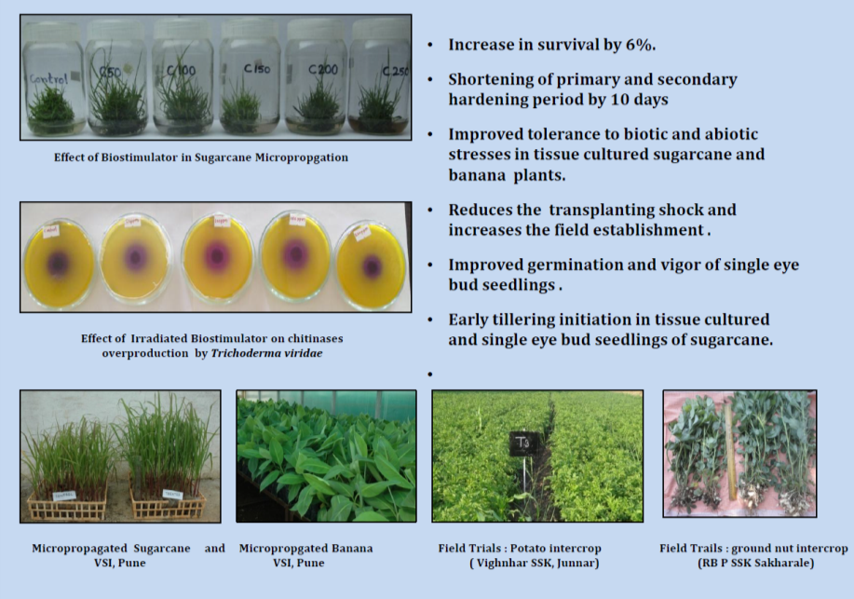
Use of irradiated chitosan as a bio-stimulator in agriculture

Slide 27
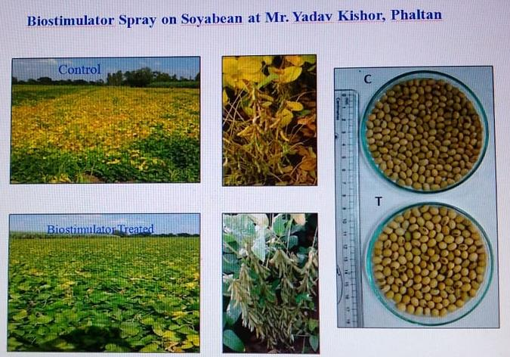

Slide 28
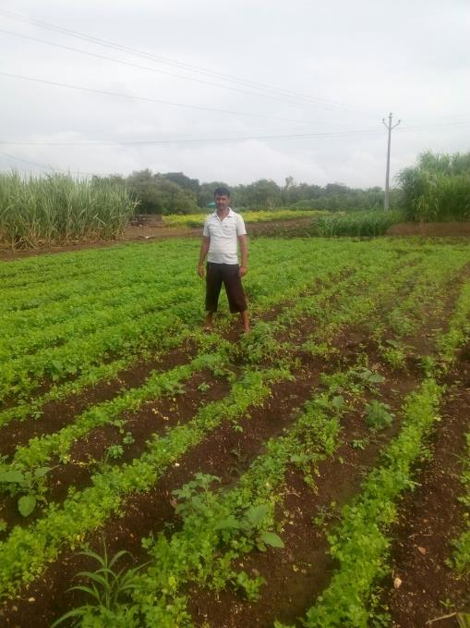
Coriander
Sprayed
No Spray

Slide 29
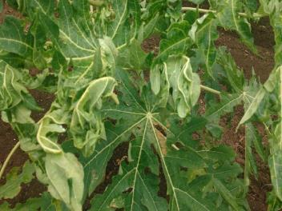
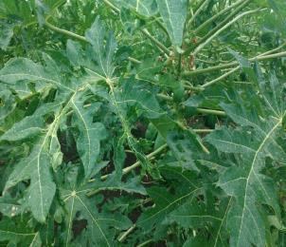
Control of papaya virus infection by foliar spray with chitosan
No Spray
No Spray

Slide 30

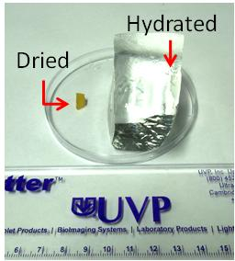
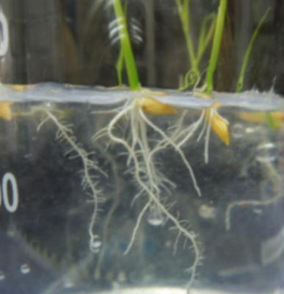
Radiation Polymerized Super-absorbent Hydrogel
High water retention (>300 times)
Biodegradable and non-toxic
Reduces irrigation frequency
Residue-free synthesis
Improves hydro-physical properties of soil
Reduces erosion and water runoff
Enhances plant productivity in arid soil
Root Infiltration in SAP

Slide 31
Pest control using
Sterile Insect Technique
Large-scale release of radiation-sterilised males
Eco-friendly: no use of harmful chemicals
Accepted and widely employed by FAO, IAEA
Can be part of Integrated Pest Management

Slide 32


Major insect pests of fruits and vegetables in India
Pod borer, Helicoverpa armigera
Cutworm, Spodoptera litura
Fruit fly, Bactrocera sp
Potato tuber moth, Pthorimaea operculella
Diamond back moth, Plutella xylostella
Tomato leaf miner, Tuta absoluta (2014 onwards)
Sucking pests: Aphids, whitefly, thrips, mealybugs, hoppers
Root feeders: Holotrichia sp
H. armigera (army worm)
Tuta absoluta feeding on tomato leaf
1st RCM-IAEA CRP
July 03-07, 2017

Slide 33




Development of SIT for melon fruit fly control
Bactrocera cucurbitae is major fruit fly pest on fruits & vegetables; damages around 30-90% production
Quarantine restrictions on export of fruits and vegetables
Annual economic losses estimated:
Rs. 7000 crore
Melon fruit fly
Irradiated pupae

Slide 34
Irradiation to control post-harvest losses

Slide 35



Food irradiation

Slide 36
Is irradiated food safe?
Accepted by international bodies and FSSSAI
After irradiation, food does not become radioactive
Nutrient loss? Marginal; similar to loss due to cooking
Enhances food safety, because of pathogen elimination

Slide 37




INSECT DISINFESTATION OF CEREALS, LEGUMES AND SPICES
(<1 kGy; after one year)
Non-irradiated
Irradiated

Slide 38












  Sprout inhibition in tuber crops
(< 1 kGy)
Non-irradiated
Irradiated

Slide 39




  Phytosanitary Treatment of Fruits: Mango, Pomegranate, Grapes (<1 KGy)
Year of Export | Mango Quantity (MT)
2007 | 157
2008 | 300
2009 | 121
2010 | 95
2011 | 84
2012 | 210
2013 | 281
2014 | 295
2015 | 329
2016 | 750
2017 | 1150

Slide 40







Radiation Processed Ready-to-Eat Fruits and
Ready-to-Cook Vegetables
a
C
I
C
I
I
C
I
C
Shelf-life can be extended to 3-4 weeks at refrigeration temperature.

Slide 41
Why food irradiation is not popular?
It is popular in US, China etc.
In India, irradiation facilities are not adequate (about 15)
Public acceptance is low; needs creation of awareness

Slide 42
Summary
Induced mutation and biotechnology will continue to play a significant role for improving food security in the coming decades
Radiation can be used for large-scale control of agricultural pests, without using harmful chemicals
Radiation based technologies can be used to reduce post-harvest losses significantly
Nuclear energy can contribute to Food and Nutritional Security

Slide 43


Seeds of prosperity
Thank You
K. H. Gharat,
Homi Bhabha’s portrait made of seeds

Slide 45



Bacillus sphaericus (Bs) based biopesticide for mosquito larvae control
Insecticidal toxins like binary toxin of Bs ISPC-8 were purified & tested against Culex and Anopheles larvae
Bs ISPC-8
Untreated
Bs treated
Biopesticide formulation was developed based on the B. sphaericus isolate ISPC -8
Biopesticide was tested under field condition in collaborations with municipal corporations

Slide 46


